Slide 1
2024 Update on
Auditing Requirements for Title IV Programs
& More
Mark Priebe
Office of Inspector General
U.S. Department of Education

Slide 2
Agenda
Introduction to Non-Federal Audit Team
Recent FSA Enforcement Information
Title IV Audit Updates

Slide 3
Abbreviations and Acronyms
Acronym | Definition |  | Acronym | Definition
AICPA | American Institute of Certified Public Accountants |  | GAAP | Generally Accepted Accounting Principles
ATB | Ability to Benefit |  | GAO | Government Accountability Office
COD | Common Origination and Disbursement System |  | IASG | Iraq and Afghanistan Service Grant
ED | U.S. Department of Education |  | OIG | Office of Inspector General
FSA | Federal Student Aid |  | PP&E | Property, Plant, and Equipment
FY | Fiscal Year |  | SFQC | Schedule of Findings and Questioned Costs

Slide 4

What’s a Non-Federal Audit?
An audit involving federal funds at a non-federal entity that is performed by either a public accounting firm or a state auditor and not by a Federal auditor (like and OIG or GAO)
It can be audits of specific programs (Title IV programs) or entity-wide audits (Single Audit)

Slide 5
Why are Non-Federal Audits Important?
ED has an annual budget of more than $79 billion dollars and hundreds of thousands of program participants.
ED relies on state and local auditors (non-Federal auditors) to regularly check up on entities receiving Federal funds to monitor how that money is spent.
The OIG NonFed Team’s role
is to make sure these audits are reliable tools that show that the entity accounted for and expended ED funds as required.

Slide 6
Non-Federal Audit Team
Provides guidance and support to auditors performing non-federal audits
Develops and updates audit guidance for proprietary schools, foreign schools, and third-party servicers
Assists in updating audit guidance for nonprofit and public schools
Participates in government-wide processes relating to audit quality and non-federal audits
Assesses the quality of non-federal audits via Quality Control Reviews and Desk Reviews

Slide 7
December 2023
FSA Enforcement Bulletin on Compliance Management Systems (General-23-113)
Institutional compliance is the first line of defense in protecting students and the integrity of federal student aid programs
Reminds schools of their obligation to establish and maintain appropriate compliance management systems and policies to:
  Reduce the risk of violations and
  Facilitate early detection of likely violations
Independent audits and other monitoring is a hallmark of an effective compliance management system

Slide 8

FSA Posting of Enforcement Actions
(GENERAL-24-102)
Information about administrative actions is being posted to improve transparency, institutional accountability, and general deterrence
Adverse administrative actions initiated on or after October 1, 2021
Supplements data already posted on:
  Fine amounts imposed since FY2010
  Current status of individuals subject to government-wide suspension and debarment actions

Slide 9
Violations and Resulting Enforcement Actions
Violations that lead to enforcement actions:
  Clery Act - Campus Security
  Drug-Free Schools and Communities Act
  IPEDS Reporting
  Institutional or programmatic accreditation
  Administrative capability and fiscal/fiduciary responsibility standards
Enforcement actions taken against schools:
  Fine
  Limitation (on # or % of Title IV students, surety requirements, or provisional certification)
  Denial of Recertification or Reinstatement
  Revocation or Termination
  Suspension or Debarment

Slide 10
Title IV Audit Updates
Recent and upcoming changes to your financial statement audit and Title IV compliance engagement

Slide 11
Division of Responsibilities for Proprietary School Audits
ED/FSA Responsibilities
OIG Responsibilities
Establish the requirement for an audit
Provide input on the types of compliance requirements tested
Decide whether to accept or reject an audit submission
Provide a management decision on audit findings
Establish the type of engagement (audit vs. attestation)
Develop the objectives and procedures
Provide technical assistance to ED and auditors
Review a sample of engagements to determine if requirements are met

Slide 12
**Refresher**
2023 Title IV Audit Guide
Effective for fiscal years beginning on or after January 1, 2023 (FYEs 12/31/23 forward)
Updated for changes in law and regulations as of the July 1, 2021, volume
Changed compliance engagement to an examination instead of an audit
Clarified and changed sampling requirements
Added and removed objectives and procedures as needed
Revised report package

Slide 13

90/10 Rule Change
For fiscal years beginning on or after January 1, 2023, schools are required to count all Federal education assistance funds as Federal revenue and are more limited in which non-Federal funds to count
CPA-23-02 addresses the rule change and revises required testing
General-23-117 addresses delayed tuition assistance payments from the ArmyIgnitED system issues
  Schools failing 90/10 solely because of the delayed payments may receive enforcement relief by following steps in this announcement
  Schools must disclose an additional 90/10 that excludes late payments and includes information about excluded payments
  Auditor must look at both 90/10 calculations

Slide 14
eZ-Audit 90/10 Template Timeline
90/10 Rule Change required extensive developmental updates to eZ-Audit, including to the 90/10 template
Oct. 2022
Final rule published
Dec. 2023
First fiscal years subject to new 90/10 rules end
Apr. 2024
eZ-Audit updates were in progress; ED asked schools to postpone submitting audits until updates are complete
June 2024
Updates won’t be complete by audit due date; ED asked schools to submit audits through COD Document Center
July 2024
Updates complete; ED asked schools to submit audits to
eZ-Audit

Slide 15
Financial Responsibility Final Rule – Oct. 2023
Revised the submission deadline for proprietary schools and foreign schools (but not servicers) to the earlier of:
  30 calendar days after the date of the auditor’s reports
  6 months after the last day of the school’s fiscal year
Revised related party transaction footnote requirements:
  Footnote now MUST include the name, location and a description of the related entity
  Requires management to add a note to the financial statements disclosing if there are no related party transactions for the year
Effective for proprietary/foreign school audits submitted on or after July 1, 2024, irrespective of when the fiscal year begins or ends

Slide 16
Subsequent Related Party Transaction Communications
OIG issued CPA-24-01
Applicable to proprietary and foreign schools, but not servicer audits
Updated the audit objective and procedures to address the change in related party footnote requirements
Auditor must ask for disclosure of all related parties and related party transactions, of which the entity is aware
AICPA issued TQA Section 6960.13
Guidance to auditors on auditing related party disclosures, including those that go beyond GAAP
Explains auditing standards allow for disclosures that go beyond GAAP to be marked as unaudited
FSA issued GENERAL-24-XXX
ED will not accept any related party disclosure marked as unaudited
ED expects schools to have a system of internal controls that will allow for compliance

Slide 17
Report Package reminders
Tips to get your audit report through the eZ-Audit Acceptability Review

Slide 18

90/10 Reporting Tips
Name individual sources of Federal funds and Grant funds; don’t use “Federal Funds 1” and “Grant Funds 1”
Review any positive adjustment and determine whether it’s in the appropriate place.
Prior year Title IV credit balances aren’t an adjustment; they have their own line item in the example footnote.
Ensure that your footnote matches what’s entered in the eZ-Audit form
  Give as much detail in the form as you do in the footnote
  Sources of Federal/Grant funds shouldn’t be combined – there are enough fields in the form to individually list sources

Slide 19
Other Financial Statement Audit Reporting Tips
Pre- and Post-Implementation
Show both pre- and post-implementation amounts for leases, debts, and PP&E
Make this disclosure easy to identify
Auditor Reminders
In-relation-to opinion on the Financial Responsibility Supplemental Schedule
Include OPEID on the title page
Reference the 2023 Title IV Audit Guide procedures for required disclosures in your Yellow Book Report

Slide 20
Use the Examples and Illustrations Provided!!
School Letterheads
Use your school letterhead (consistently) for the Corrective Action Plan and the Summary Schedule of Prior Audit Findings
Auditor’s Examination Report
Include required statement on independence and ethical responsibilities
School Information Sheet
Don’t use portions of old Servicer Information Sheets
Include at least headings for all Parts I through VIII
Parts I through IV apply to all schools; present as shown in example
Parts V through VIII, may be marked as “Not Applicable”
Part VIII may list only services provided by a servicer

Slide 21
Tips for Auditors Reporting Material Noncompliance
Clearly identify the noncompliance as Material in the SFQC
Include your definition of materiality for that requirement
When a sample was involved, report estimated percentage of errors and estimated questioned costs (when questioned costs are identified) for the universe, using required confidence levels
  You may have to expand your sample to achieve required confidence levels
  The point of an expanded sample is not to achieve a lower error rate, but to perform sufficient work to be able to project your sample results to the universe.
  Whether or not you had to expand your sample, state that your sample was statistically valid

Slide 22

Planned Audit Guide Updates

Slide 23

Reminder to Auditors on
Audit Guide Safe Harbor
Title IV requirements change regularly, and the audit guide identifies those requirements that are subject to examination and establishes related examination objectives.
You must perform procedures to achieve the stated objectives
  Perform reasonable procedures to identify any changes in areas subject to examination
  Auditor judgment is necessary to determine whether required procedures are still sufficient to achieve the objectives
  Alternative or additional procedures may be needed

Slide 24
Updates for
Fafsa simplification Act
Incorporate new terminology
Transition from Expected Family Contribution to Student Aid Index
Address changes to needs analysis process
Changes to Pell Grant calculation
Replace IASG with the Special Rule for Pell Grants
Will include a summary of issues encountered with 2024-25 FAFSA and any flexibilities granted in areas subject to audit testing

Slide 25
Updates for Final Rule on Financial Responsibility, Administrative Capability, Certification Procedures, and ATB
Procedures to evaluate the validity of a student's high school diploma
Programs must meet requirements for licensure or certification in the state where distance ed students are located or intend to seek employment
Reduced maximum length of gainful employment programs (depending on the outcome of the injunction)
Updates to the approved State process for ATB
Additional requirements for Eligible Career Pathways Programs

Slide 26

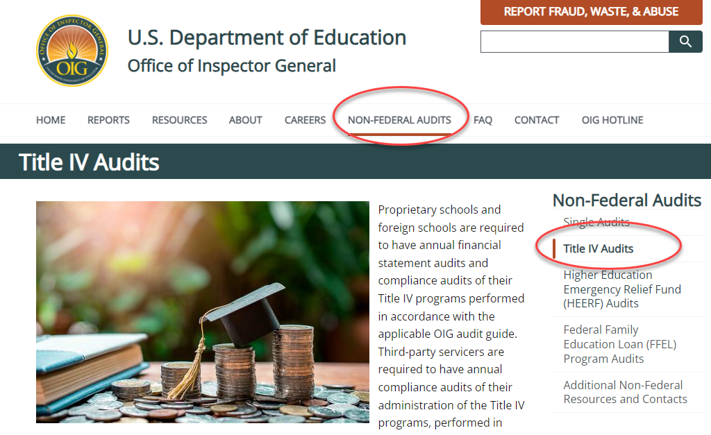
Visit Our Site at OIG.ED.GOV

Slide 27
THANK YOU
Mark Priebe​
OIGnon-federalaudit@ed.gov​
https://oig.ed.gov/non-federal-audits

